Slide 1


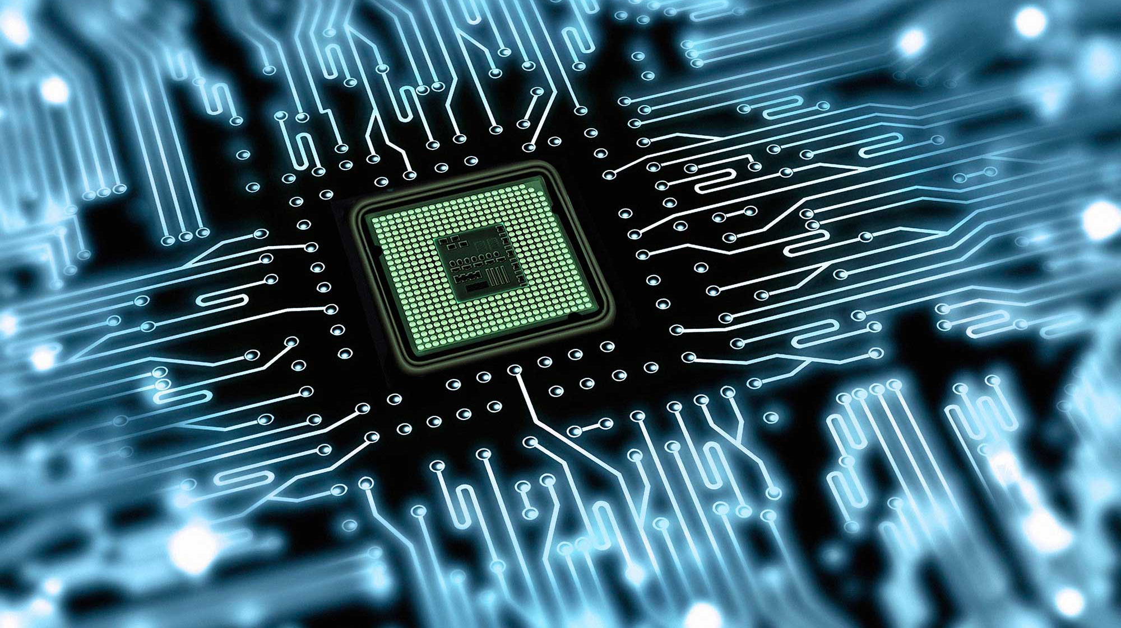
Data Compression
By Sam Feig

Slide 2
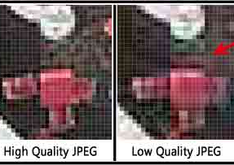
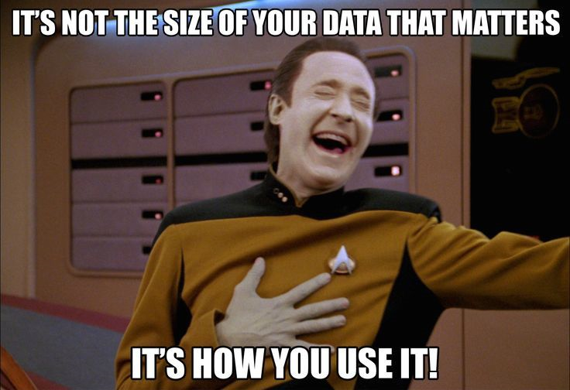
Background/History
Reducing the size of a file
Lossy vs Lossless
Effectiveness depends on data being compressed (no universal algorithm)
Modern lossless compression ratios are around 2.5:1 – 3.5:, Hutter Prize record is 6.54
Notes:
JPEG and MP3/MP4 are lossy, ZIP, RAR, PNG, GIF are lossless
Hutter Prize is to compress 100MB of Wikipedia data to the smallest size possible in under 8 hours.

Slide 3
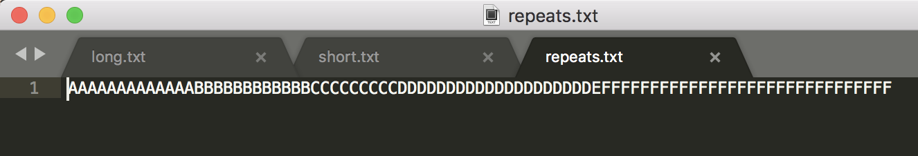
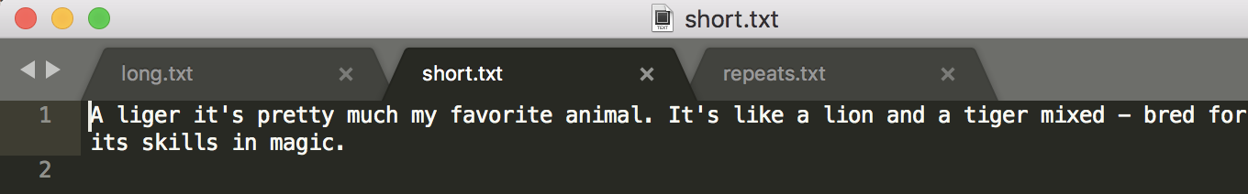
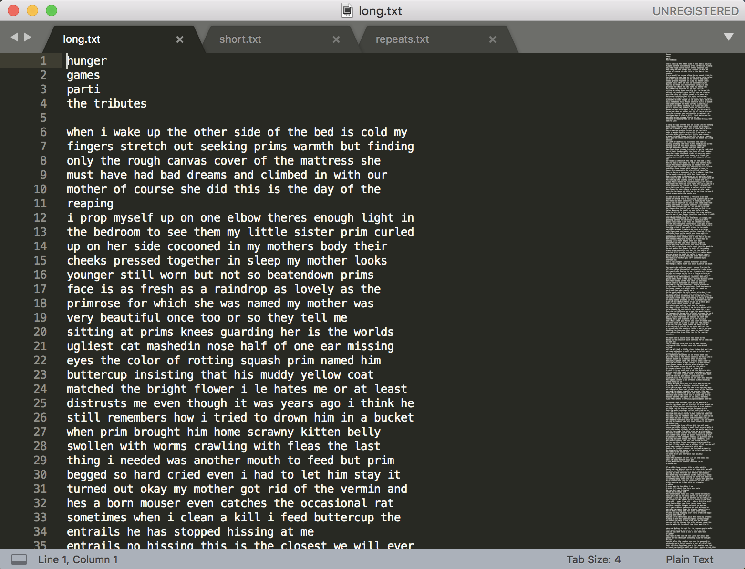
Data Used
All standard text files of varying sizes
Short to test special cases
long to emulate standard documents it would encounter

Slide 4
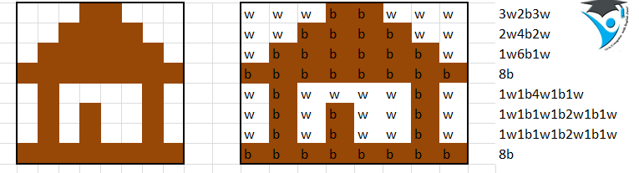
Run Length Encoding
Lossless, based on repeated characters
Great for data with large number of repeated characters in a row
Used in early image compression (black and white images)

Slide 5
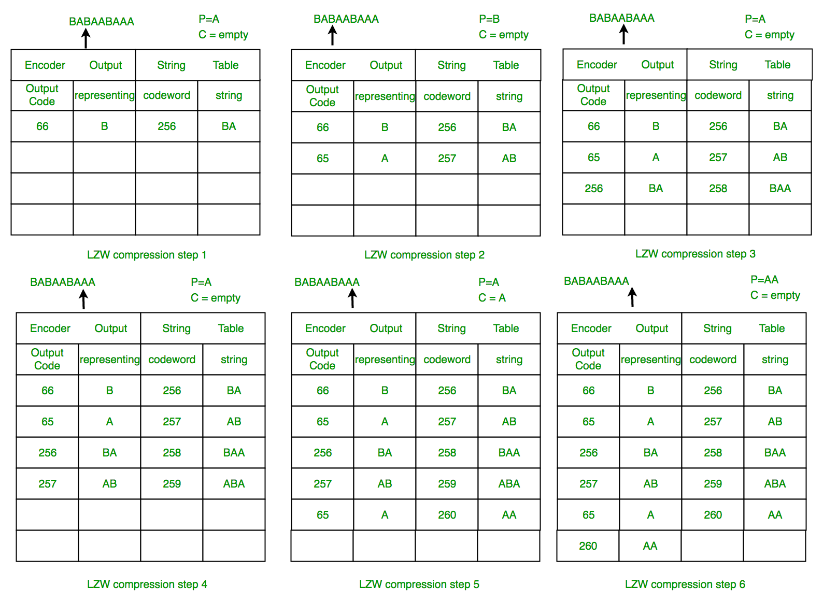
Lempel–Ziv–Welch (LZW) Compression
Invented in 1978, improved in1984
Lossless, dictionary based
Need no prior information about file but takes longer
Used in UNIX, GIFF, and TIFF compression, variations used in many other applications
Notes:
Still commonly used in the back end of modern compression
Common dictionary of 256 Unicode characters initially with max dictionary of 4096 entries (2^12)

Slide 6
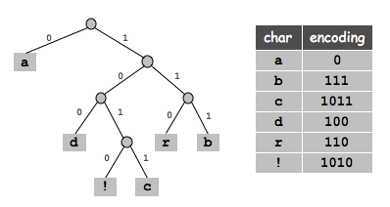
Huffman Compression
Invented in 1952
Lossless, entropy based
Need prior information about file (frequency of character occurrences) but much faster than LZW
Modified versions used in most modern compression including JPEG, MP3, and ZIP
Notes:
Still commonly used in the back end of most modern compression
priority queue to to generate binary tree to store encodings

